Slide 1
Unit 4 : Organizing

Slide 2
Concept
Organizing, is the management function that follows after planning, it involves the assignment of tasks, the grouping of tasks into departments and the assignment of authority with adequate responsibility and allocation of resources across the organization to achieve common goals.
It is concerned with setting the structure and framework and arranging resources to perform required activities.
Organizing is the process of identification of major activities, grouping them into units, assignment of work to staff and delegation of authority.
It is the process of combining together all the organizational resources and establishing productive relation among them.

Slide 3
General responsibilities in this regard include:
Firm Activities - Determine the necessary activities and classify them.
Grouping - Group company activities into workable departments.
Responsibility - Assign authority and responsibility to subordinate managers.
Relationships - Develop a working relationship between superiors and subordinates within the department or sub-unit.
Rules - Create policies, procedures, and a plan for supervision.

Slide 4
Process of organizing
Determination of work
Division of work
Grouping of work
Assigning duties
Delegation of authority
Coordination of work
Follow up

Slide 5
Principles of organizing
The major principle are:
1.Unity of Objectives
The unity of objectives principle assumes that the objectives of the organization must be known to each department, section, and even each position in the organization structure.
This principle implies that the objectives of various departments and sections of enterprises must be formulated in such a way that every individual can contribute his/her efforts for a single objective.
For this, common objectives of the enterprise should be defined first and then they should be divided into every department and section. By doing this every individual is informed and leads to complete the work on time.

Slide 6
2.Specialization
This principle of organizing implies that as far as possible each individual of the organization should be given a specific task based on his/her ability. In such a situation, employees can concentrate on single work with greater efficiency.
It assumes that giving multiple tasks to a single employee creates confusion in the mind of that employee, he can be frustrated, he can not meet the determined standard, time, and cost, and thus there can be lateness in completing the work.

Slide 7
3.Coordination
Every organization is established for a definite objective. For the accomplishment of defined objectives, many departments are created and many persons are appointed. All the departments and persons involved in various activities have a common goal.
Coordination among various departments and activities is one of the crucial parts of organizing. This principle facilitates the creation of harmonious working relationships among departments and employees. It also integrates the efforts of all individuals in the enterprises.

Slide 8
4.Authority and Responsibility
Authority and responsibility are two wheels of a cart.
There must be a balance between these principles of organizing. When an individual is responsible for a particular task, he should be given the required authority to complete the given task efficiently.
Without proper authority, an employee can not fulfill his responsibilities effectively. Similarly, sufficient authority to an employee without responsibility may result in the misuse of authority. So, it is essential to be a balance between authority and responsibility of the employees.

Slide 9
5.Unity of Command
This principle ensures that an employee should receive orders and instructions from only one superior at a time. When he is answerable to more than one superior at a time, he can not fulfill his duties in the required time.
While receiving orders and instructions from two or more superiors he may come into confusion for taking priority of superior instructions. Thus, it is essential for the unity of command in the organization.

Slide 10
6.Scalar Chain
This principle implies the unbroken line of authority from the top level to the lowest level of an enterprise. It is a root of communications from the top level to the lower level and from the lower level to the top level. It also promotes mutual understanding among subordinates and superiors.
The chain of command must be clear and short for its effectiveness.

Slide 11
7.Span of Control (नियन्त्रण दायरा)
This principle of organizing refers to that there should be a limited number of subordinates under a supervisor so that their work can be effectively supervised. In fact, several factors determine how many subordinates a supervisor can supervise.
The narrow span ensures close and effective supervision as there is a limited number of subordinates under the supervisor. Similarly, a wide span makes simple supervision of the subordinates. Therefore, depending upon the size and nature of the enterprises, there must be manageable numbers of subordinates under a supervisor to make effective supervision.

Slide 12
8.Exception
This principle emphasizes that the top-level manager must concentrate only on exceptional and creative issues. These activities involve planning, policy-making, setting long-term objectives, and formulation of strategies.
9. Efficiency
For this purpose, optimum utilization of resources is essential.
A manager has to make and develop a strategy for better utilization of organizational resources including human resources. And ultimately an efficient organizational structure ensures optimum utilization of organizational resources.

Slide 13
10.Balance
According to this principle, there must be an equal division of work among all departments and sections of an organization. There must be a balance between efficiency and effort.
11. homogeneous
This principle implies every department should be assigned only homogeneous functions. It means functions of similar nature and has the same objectives should be divided into one group. This helps to ensure unity of direction and coordination of efforts.

Slide 14
12.Simplicity
This principle emphasizes that the management must design a simple organizational structure. It should be designed in such a manner that all the members of the organization understand it easily.
All members of the organization from top-level to bottom level should understand their line of authority and responsibility. It provides a framework for better cooperation among all the members.

Slide 15
13.Continuity
Organizing is the continuous process up to the existence of the organization. It must be watched from time to time.
The organizational structure should be reviewed and revised according to the changing environment of business. The organizational structure must be reviewed and modified according to the demand of the situation.
14. Flexibility
Organizational structure should be changeable according to the changing environment.

Slide 16
Organization Architecture
The term organization architecture refers to the totality of a firm’s organization structure, control systems, incentive systems, organizational culture, and people.
Strategy: the core approach the organization will use to accomplish its goals.
Structure: How people are situated in units and how their work is coordinated.
Systems: The process used to add value.
Skills: The capabilities of the various groups of people in the organization.
Culture: The values, norms and assumptions that shape behavior.

Slide 17
Organization structure can be thought of in terms of three dimensions: vertical, horizontal and integrating mechanisms.
1. Vertical Differentiation
which refers to the location of decision-making responsibilities within a structure (that is, centralization or decentralization) and also to the number of layers in a hierarchy (that is, whether the organizational structure is tall or flat).
Centralization is the concentration of decision-making authority at a high level in a management hierarchy.
Decentralization decision-making authority in lower-level managers or other employees.

Slide 18
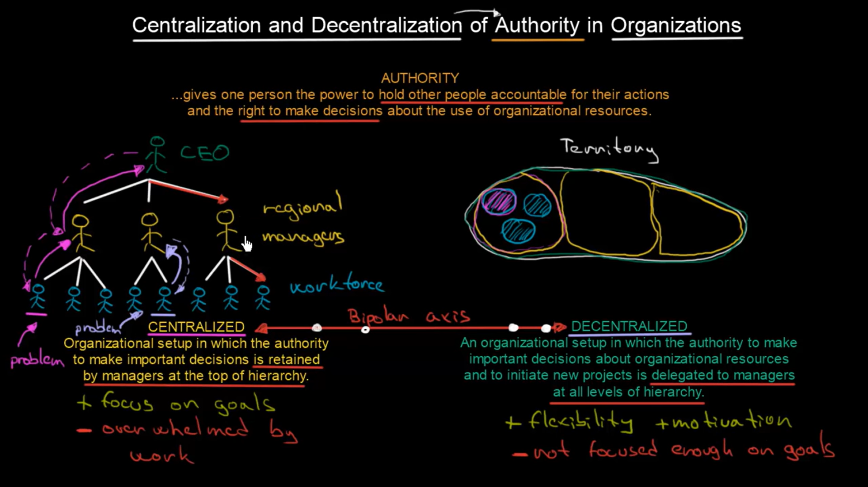

Slide 19
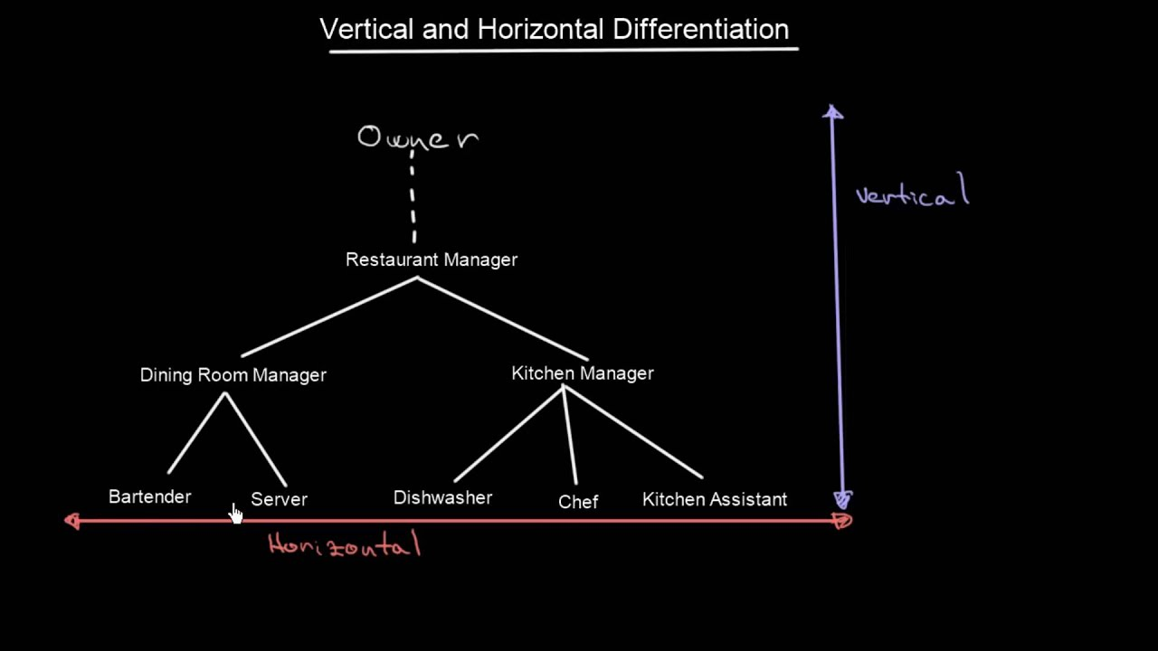

Slide 20
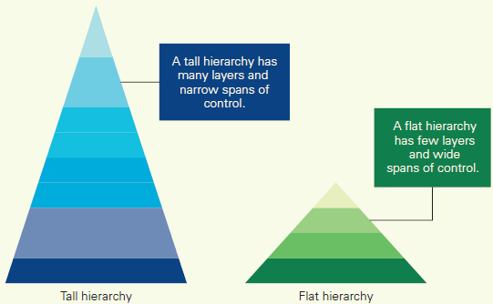
TALL VERSUS FLAT HIERARCHIES

Slide 21
A second aspect of vertical differentiation refers to the number of levels in an organization’s hierarchy. Tall hierarchies have many layers of management; flat hierarchies have few layers. Most firms start out small, often with only one or at most two layers in the hierarchy. As they grow, however, managers find that there is a limit to the amount of information they can process and the control they can exert लगाउनु over daily operations.

Slide 22
In a vertical organization, your business has a pyramidal top-down structure, with a CEO, president or owner at the top, a middle section of managers and supervisors, and a bottom section of regular employees. As a business owner, you would make all the major decisions about marketing, sales, and customer service standards, then communicate those decisions to your middle management. These managers would then be responsible for telling your employees the work processes that will achieve desired goals. The word “vertical” refers to the fact that the organization works from the top to the bottom, and that employees are not required or expected to contribute to the choices that you make regarding how the company operates.

Slide 23
Advantages:
Better defines levels of authority and responsibility
Shows who each person reports to or who to talk to about specific projects.
Motivates employees with clear career paths and chances for promotion
Gives each employee a specialty
Creates friendship between within the same department

Slide 24
Disadvantages:
can slow down innovation or important changes due to increased bureaucracy.
Can cause employees to act in interest of the department instead of the company as a whole.
Can make lower level employees feel like they have less ownership and can’t express their ideas for the company.

Slide 25
2. Horizontal differentiation
In a horizontal organization, your business has a flat structure, which means there are very few managers and more authority is granted to rank-and-file employees. This system allows employees to feel empowered, because they can make important decisions without needing approval from a manager. Rather than having to satisfy a manager, employees in a horizontal organization are motivated and driven by company goals, which can improve efficiency and morale.
Which refers to the formal division of the organization into subunits.
Horizontal differentiation is concerned with how to divide the organization into subunits. We look at four different types of structure here: functional, multidivisional, geographic, and matrix.

Slide 26
Functional structure
A functional organizational structure is a structure used to organize workers. They are grouped based on their specific skills and knowledge. It vertically structures each department with roles from the president to finance and sales departments, to customer service, to employees assigned to one product or service. Functional organizations contain specialized units that report to a single authority, usually called top management.
Thus there might be a production function, an R&D function, a marketing function, a sales function, and so on. These functions are typically overseen by top manager, such as the CEO, or a small top management team.

Slide 27
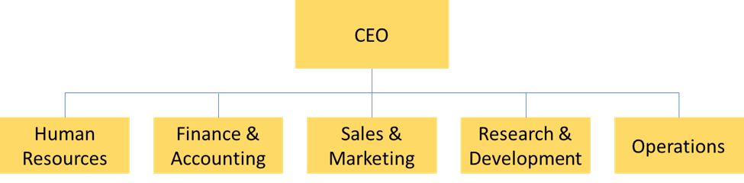

Slide 28
Advantages:
Benefits of specialization
Increase efficiency
Healthy competition among experts
Relief to executive
Mass production
Facilitates growth and expansion
Suitable for present environment

Slide 29
Disadvantages:
Multiple command system
Lack of coordination
High administrative cost
Delay in decision making
Narrow outlook of specialists
Shifting responsibility

Slide 30
b. Multidivisional structure
It is based on multiple business operating within a larger organizational framework.
In a multidivisional structure the firm is divided into different product divisions, each of which is responsible for a distinct business area.
Eg. In a manufacturing company, rice production department, sugar production department, sugar production department etc.

Slide 31
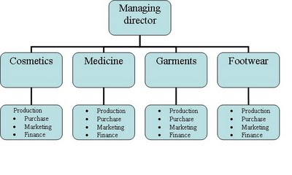

Slide 32
Advantages 1.Suitable 2.Facilitates specialization 3.Maintain direct attention 4.Effective monitor and evaluation 5.Optimum use of resources 6.Efficiency integration | Disadvantages 1.Source of conflict 2.Under utilization of capacity 3.Problems for effective control 4.Maximize administrative cost 5.Difficulty in coordination 6.More inter-dependency 7.Ignore common goal

Slide 33
c. Geographic Structure
A geographical organizational structure organizes people within an organization by geographic location. This structure creates specific divisions for each location. Each division acts as if it is its own company, combining different types of personnel for various business functions. For example, each division may have its own marketing department, production department, sales department, distribution department and more.
Geographic organizational structures are often well-suited for very large entities, such as automobile manufacturers, who need to locate production facilities in which labor costs are favorable and supplies readily available, but also need support organizations for dealerships that are located everywhere the company's autos are sold.

Slide 34
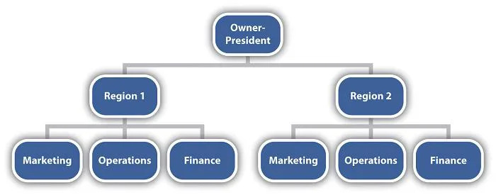

Slide 35
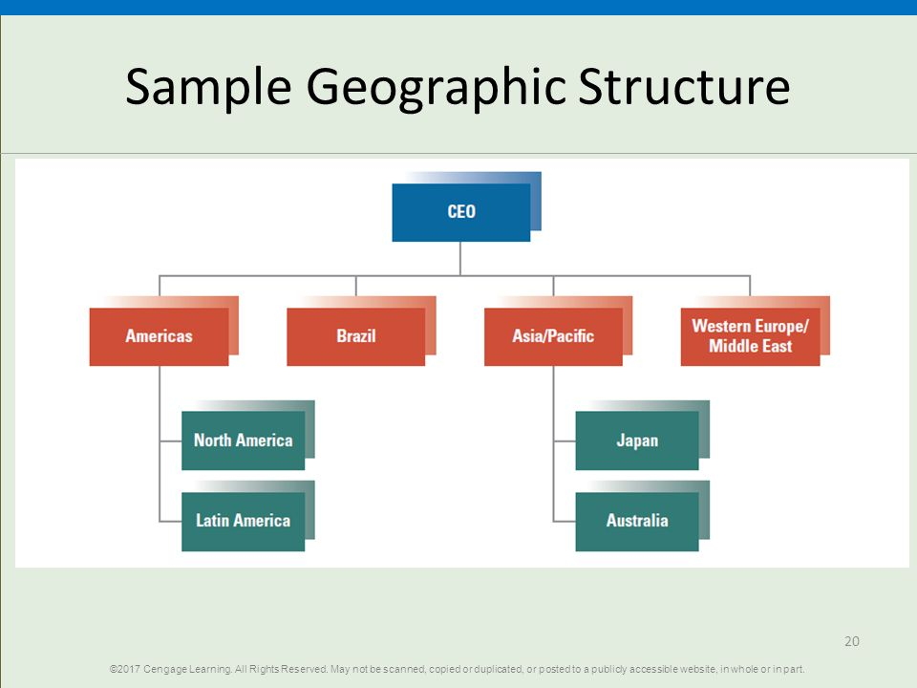

Slide 36
Advantages | Disadvantages
Helps large companies stay flexible | All the function are duplicated at each location
Knows the customers problem | It may cause conflict between each location’s objectives and corporate objectives.
Allows for a quicker response to industry changes or customer needs | It may require extensive rules and regulations to coordinate and ensure uniformity of quality among locations.
Promotes independence | It doesn’t foster employee’s knowledge of problems at other locations.
Easier to coordinate | Lack of company culture
Ability to track profits | Difference in employee expertise
Better efficiency for division

Slide 37
Advantages of geographical organizational structure
Better efficiency for division
Geographical organization structures combine employees from different specialties. This may help locations develop solutions and respond to clients faster. This may help with more efficient operations than at a centralized location.
Easier to coordinate
With geographical organization structures, each local division acts as its own business. All members of the business works in the same location. This makes it easier for employees to coordinate meetings with each other and meeting the challenges of the specific geographic location.
Improved focus
Working in local divisions allows employees only to focus on the objectives of their specific location. This may improve operational efficiency and overall results. Companies may enjoy increased profitability as a result.
Leadership opportunities
The local divisions of businesses with geographical organizational structures require managers with effective leadership at each location. This provides managers with the opportunity to complete on-the-job training and gain valuable experience. These leadership opportunities train managers how to lead at the top of the chain of command, preparing them for potential C-level positions within the company.

Slide 38
Ability to track profits
The geographic sales organization structure allows company to better track their profits based on location. Companies can track the sales performance for specific geographic locations or divisions. Also, different regions may have different profit margins, sales practices and revenues based on customer demands.
Improved customer communication
The local divisions created by geographical organizational structures often allows for improved customer communication. Local managers can maintain a regional focus, tailoring the division's operations to best fit the needs and demands of the local customers. Also, working locally often allows employees to communicate with and build and maintain relationships with customers more easily.
Flexible market response
Geographic divisions are familiar with the local conditions of the area they serve. They're able to better monitor geographic changes. Divisions have the autonomy to make decisions related to altering operations in response to changes in customer demands, needs or preferences.

Slide 39
Disadvantages of geographical organizational structure
Duplicate activities
Each division within a geographical organizational structure has their own departments. For example, each location has its own marketing department, research department, warehouse and more. This may lead to duplicate activities throughout the company. While departments at each individual location may increase efficiency at the location, it may decrease overall efficiency for the company.
More expensive
Geographic organization structures may be more expensive. These structures may use more resources, especially with duplicate infrastructures or activities within the organization. Companies with this organizational structure may sacrifice economies of scale. Production may increase, but costs may also increase.

Slide 40
Competition for resources
Some companies may have limited access to resource. This may make it difficult to supply each division with the resources it needs. This may cause scarcity and unhealthy competition across divisions.
Difference in employee expertise
Each division employs employees with different backgrounds and expertise. These diverse teams provide their division with unique strengths and a better understanding of the local area. However, expertise will vary at different locations, possibly causing inconsistencies in the company's efforts.
Potential conflict
The divisions in companies with geographical organizational structures often have autonomy to make their own decisions. However, this decentralized approach to decision making may cause conflicts between local division management and central or corporate management at headquarters. As a result, corporate management may impose policies on the local divisions that reduce their autonomy.
Lack of company culture
Companies with geographical organizational structures may struggle to develop a cohesive company culture. There may be difficulties communicating or coordinating among different divisions. However, each division may develop its own strong company culture.

Slide 41
d. Matrix structure
A structure in which people and resources are grouped in two ways simultaneously by function and by project or product
A matrix structure is a combination of two or more types of organizational structures. It is a way of arranging your business so that you set up reporting relationships as a grid, or a matrix, rather than in the traditional hierarchy.
In this structure, employees usually have dual reporting relationships - generally to their functional manager as well as the project manager. Typically, one reporting line will take priority over the other (eg staff may have to report to their functional manager before reporting to the project manager).

Slide 42
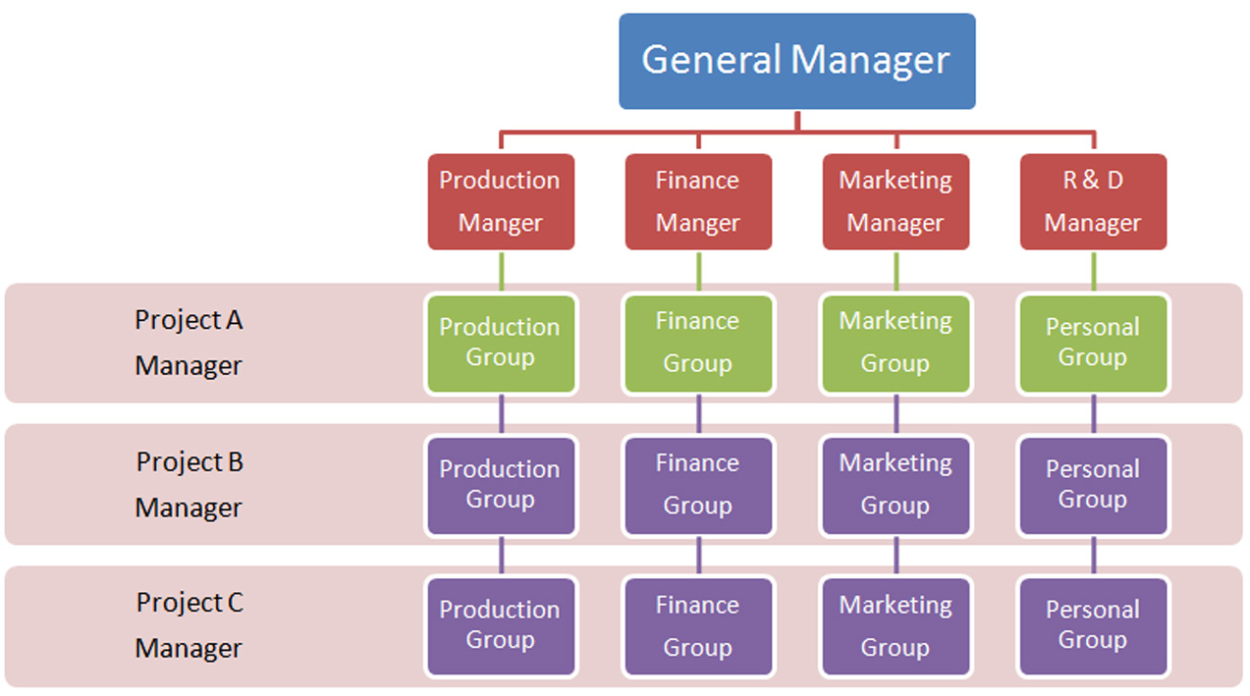

Slide 43
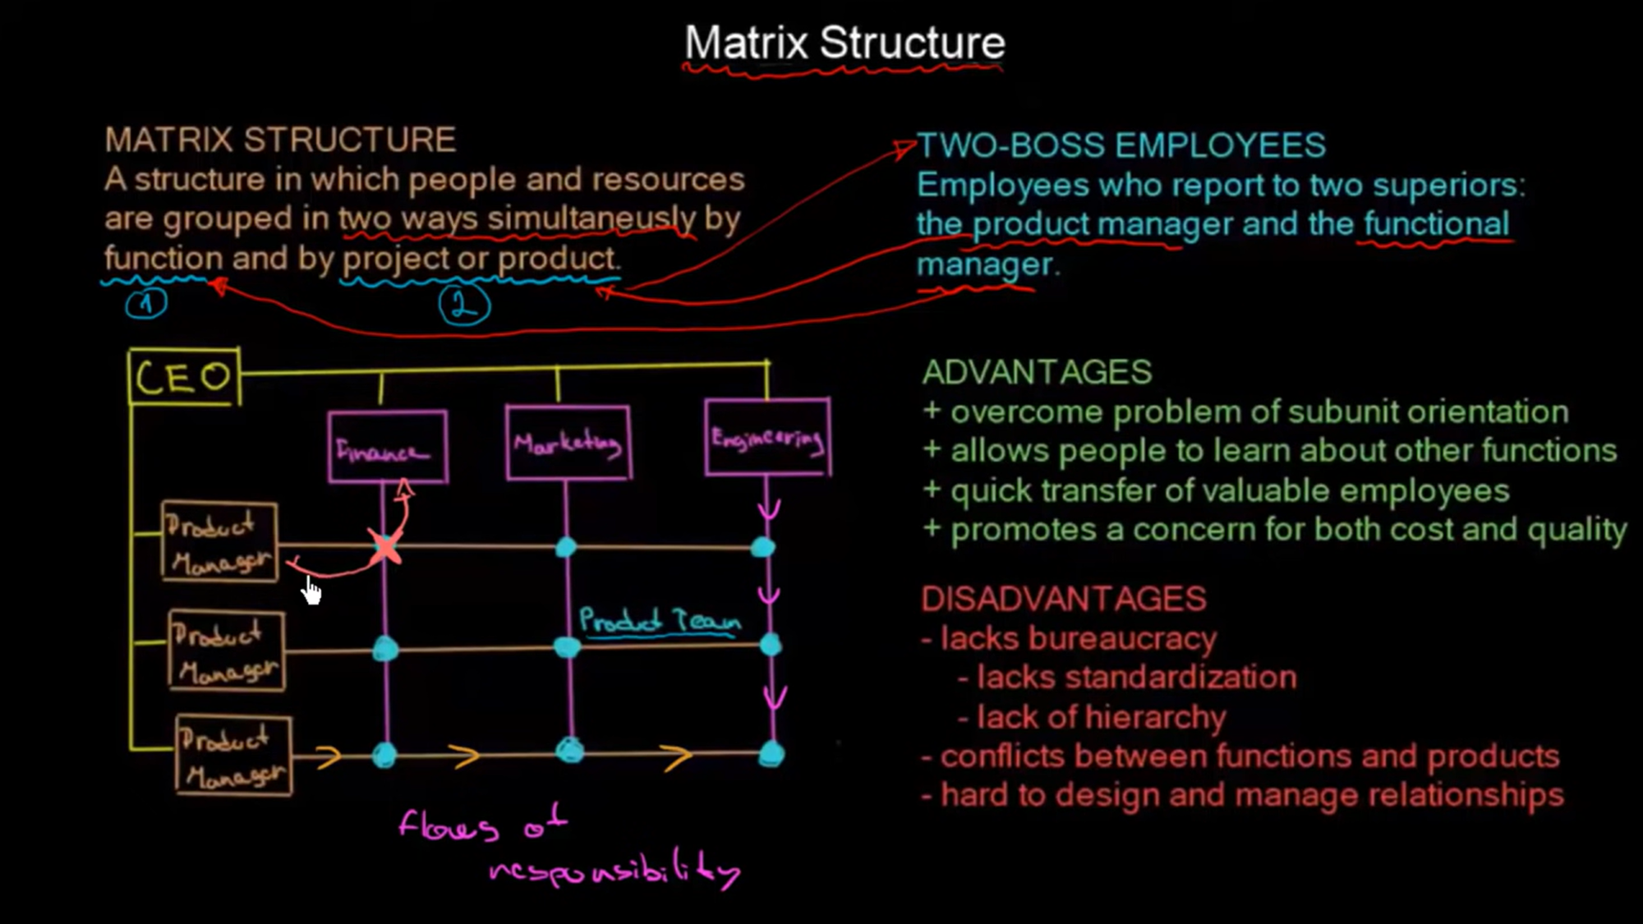

Slide 44
Examples of matrix structure
Different forms of matrix structure exist. These fall under three main categories, depending on the level of power of the project manager:
Functional or weak matrix - the functional manager retains most of the power and is in charge of the people and resources. The project manager has a minimal role and tends to carry out administrative or coordinating tasks.
Strong matrix - the project manager holds most of the power and authority, controls the project budget and manages staff. The role of the functional manager is limited.
Balanced matrix - the functional managers and the project managers share the power and the authority over staff and budget.
In large organizations, it is possible to involve all these types of matrix structure at different levels within a business. This is sometimes referred to as a 'composite organization'.

Slide 45
Advantages
The advantages of a matrix organizational structure
The main advantage of the matrix structure is that it can:
improve decision-making, since there are two chains of command
help break down traditional 'silo' barriers(In business, organizational silos refer to business divisions that operate independently and avoid sharing information)
improve communication across the business
allow staff to apply their skills in different roles
help share best practice and ideas across teams
increase efficiencies due to sharing resources across departments
The matrix structure can also help businesses achieve quick market adaptation to changing customer needs, as it can decrease the lead time to produce a new product. This structure is most suitable for businesses operating in a dynamic environment.

Slide 46
Disadvantages
The disadvantages of a matrix organizational structure
A matrix structure may not be well suited for businesses working in a more settled environment, with set customer requirements. Because of its complexity, and the need for employees to report to two bosses, it can lead to:
confusion regarding roles, responsibilities and priorities
divided loyalties between project teams
blurred lines of accountability
difficulties in coordinating tasks or functions
power struggle between the project manager and the functional manager
large overhead costs, on account of having multiple managers

Slide 47
Authority
The power or right to give orders, make decisions, and enforce obedience.
A person or organization having political or legal or administrative power and control.
Power to influence or command thought, opinion, or behavior
Authority is the ability of a person or an organization to conduct a certain lifestyle for another person or a group….authority is made by a certain social power. This power might be materialistic ( such as threat to harm someone) or fictitious (such as belief in a certain person’s power)
Two types of authorities are discussed below:

Slide 48
1. line authority
Line authority is the power given to someone in a supervisory position to mandate actions by subordinates. This authority is given so that an organization can attain its stated goals and objectives. It is a common characteristic of the hierarchical organizational structure. Examples of managers within a business who have line authority are the controller, engineering manager, production manager, and sales manager.
It is hierarchical form of authority
It is employer-employee authority relationship that extends from top to bottom.
Line manager directs the work of employees and makes certain decisions without consulting anyone.
Top management has complete control.

Slide 49
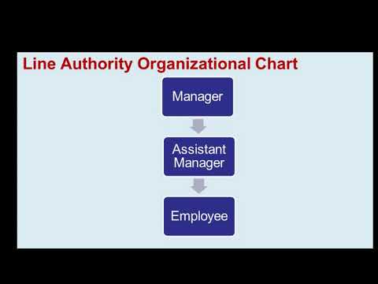

Slide 50
Advantages of line authority
1. Simplicity. It is the simplest form of organization and very simple to understand and implement. It can be easily define and explain to all staff.
2. Responsibility is fixed. In this form of organization responsibilities are fixed and defined. Every person is crystal clear to whom he is answerable and who are accountable to him. In this type of organization shifting of responsibility is not possible because responsibilities are fixed.
3. Unified Control. Good control, direction and direction is possible in line organization because of fixed responsibility. Lower level personnel favorably react to simple the multiple authority.
4. Quick Decision. Single authority, unified control and fixed responsibility to help in quick decision.

Slide 51
5. Flexibility. In type of organization is flexible in character. This is capable of adjusting itself quickly to changing circumstances. This obviously flows from fixed responsibility because of which the executive is sole master in his own sphere of activity.
6. Economical:
Line organization is easy to operate and less expensive. There are no staff personnel to advise line officers. Line officers take their own decisions without looking to specialized personnel. This greatly reduces the establishment cost.
7. Effective communication
The chain of command goes from top to bottom. There is a direct link between the superior and his subordinate, both can communicate properly among themselves. The reactions of subordinates also reach top management in a short span of time.

Slide 52
Disadvantage of line authority
1. Over loading. The executive is overloaded at each level of organization. There are several things he must manage independently. Here his level of efficiency is not the same that is why most of the time the organization activities suffer due to overloading.
2. Lack of Specialization. Different types of jobs are looked after, supervised and control by executive. It is physically not possible for him to learn and acquire the skills of the jobs he looks into and at the same time be able to do justice to each job. He cannot claim to be an expert in all types of jobs he handles. Today complex business and industrial organizations need specialization. If unfortunately it is not there the attainment of objectives may not be smooth.

Slide 53
3. Lack of Co-ordination:
There is a lack of co-ordination among various departments. All departmental heads try to run the departments in their own way and according to their suitability. There may be a lack of operational uniformity among various departments. This may become the reason for lack of co-ordination among different departments. This may become the reason for lack of co-ordination among different departments.
4. Improper Communication:
The ultimate authority for taking all decisions lies with line officers. The line officers may become autocratic and start deciding things without consulting their subordinates. The subordinates start keeping distance from the superiors. The decisions are implemented without comments even if these appear to be detrimental to the interests of the organization. The subordinates do not convey their reactions or the reactions of workers to the superiors. The lack of communication creates many problems for the smooth conduct of business.

Slide 54
5. Lack of Initiative:
In line organization final decision-making is done by the top management. The lower level officials do not show initiative in suggesting new things. They feel that their suggestions may not carry weight with their superiors so they avoid taking any type of initiative.
7. Instability:
The business is dependent upon some key persons and the sudden disappearance of such persons from the scene may create instability in the business. There is also a lack of grooming the new persons for taking up important work. The managerial growth also suffers because lower level persons are not involved in decision-making process.

Slide 55
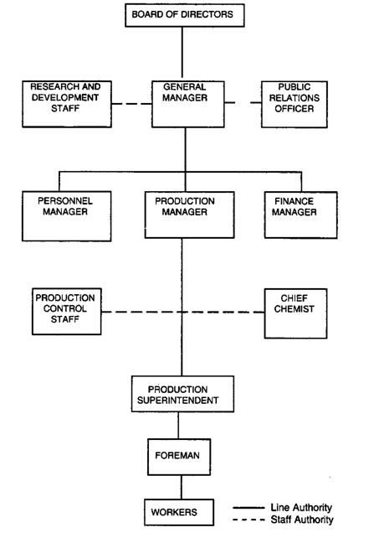
2. Staff Authority

Slide 56
Staff authority is the provision of advice and other services to line managers. People in these staff positions are empowered to assist the line functions (such as production and sales), but do not have any authority over them. As an example of staff authority, the cost accountant advises the sales manager on which products have the highest margins, and so are the most valuable products to sell. Senior managers need to be careful about limiting the number of staff positions; otherwise, a business could develop an excessive amount of corporate overhead.
Staff authority refers to the right to advice on improving the effectiveness for line employees in performing their duties. Staff personnel are generally independent employees who do not report to line managers, and they can be external staff who are temporarily employed to perform a particular task. These are highly specialized individuals, thus are employed for their expert knowledge and the ability to add value to the company.

Slide 57
Advantages of Line and Staff Organization
Specialization. Line and staff organization introduces a specialization in a very systematic manner. ...
Better Discipline. ...
Balanced and Prompt Decisions. ...
Growth and Expansion. ...
Development of Employees. ...
Lesser(few) Burden on Line Officers. ...
Quick Actions.

Slide 58
Disadvantages of Line and Staff Organization:
Conflict between Line and Staff Personnel:
Lack of Responsibility: There is a lack of responsibility for staff officials. ...
More Dependence on Staff: The line officers become habituated for advice on staff. ...
Lack of Co-Ordination: ...
Ineffective Staff: ...
Expensive:

Slide 59
Line Authority vs Staff Authority
Line authority is the type of authority that reflects superior-subordinate relationships characterized by the power of decision making. | Staff authority refers to the right to advice on improving the effectiveness for line employees in performing their duties.
Main Responsibility
Line managers are responsible for directing, motivating and supervising employees towards achieving organizational goals. | Main responsibility of line staff is to provide expert advice and support to line staff to allow smooth flow of operations.
Specialization
Level of specialization is low in line authority. | High specialization is seen in staff authority.
Adaptation to Environment
Line authority is mostly suitable for small and medium scale organizations. | Staff authority can bring wider benefits for large-scale organizations.

Slide 60
Advantages
It brings expert knowledge to bear upon management and operating problems. Thus, the line managers get the benefit of specialized knowledge of staff specialists at various levels.
The expert advice and guidance given by the staff officers to the line officers benefit the entire organization.
As the staff officers look after the detailed analysis of each important managerial activity, it relieves the line managers of the botheration of concentrating on specialized functions.
Staff specialists help the line managers in taking better decisions by providing expert advice. Therefore, there will be sound managerial decisions under this system.
It makes possible the principle of undivided responsibility and authority, and at the same time permits staff specialization. Thus, the organization takes advantage of functional organization while maintaining the unity of command.
It is based upon planned specialization.
Line and staff organization has greater flexibility, in the sense that new specialized activities can be added to the line activities without disturbing the line procedure.

Slide 61
Disadvantages
There is generally a conflict between the line and staff executives. The line managers feel that staff specialists do not always give right type of advice, and staff officials generally complain that their advice is not properly attended to.
Line managers sometimes may resent the activities of staff members, feeling that prestige and influence of line managers suffer from the presence of the specialists.
The staff experts may be ineffective because they do not get the authority to implement their recommendations.
This type of organization requires the appointment of large number of staff officers or experts in addition to the line officers. As a result, this system becomes quite expensive.
Although expert information and advice are available, they reach the workers through the officers and thus run the risk of misunderstanding and misinterpretation.
Since staff managers are not accountable for the results, they may not be performing their duties well.
Line mangers deal with problems in a more practical manner. But staff officials who are specialists in their fields tend to be more theoretical. This may hamper coordination in the organization.

Slide 62
Delegation Authority
The Delegation of Authority is an organizational process wherein, the manager divides his work among the subordinates and give them the responsibility to accomplish the respective tasks. Along with the responsibility, he also shares the authority, i.e. the power to take decisions with the subordinates, such that responsibilities can be completed efficiently.
In other words, a delegation of authority involves the sharing of authority downwards to the subordinates and checking their efficiency by making them accountable for their doings. In an organization, the manager has several responsibilities and work to do. So, in order to reduce his burden, certain responsibility and authority are delegated to the lower level, i.e. to the subordinates, to get the work done on the manager’s behalf.

Slide 63
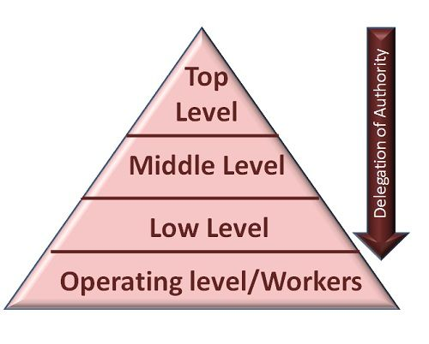

Slide 64
Features
Downward process
Partial delegation
Authorized person
No delegation of responsibility
Parity of authority and responsibility
Right to recall
Superior subordinate relationship
Delegation for organization purpose

Slide 65
Benefits Or Advantages Of Delegation Of Authority
1. Specialization
Authorities and responsibilities are delegated as per the skills, abilities, knowledge and experience of subordinates. So, delegation of authority promotes specialization and division of work in the organization.
2. Reduce Pressure And Workload
In delegation, routine tasks are assigned to middle level and lower level managers. It reduces the pressure, stress and workload of top level manager. Manager get enough time to conduct other important creative and productive activities
3. Quick Decisions
Lower level managers get the authority to make decisions which helps to improve their decision making power. They do not need to consult top managers to take decision which ensures prompt decisions at the workplace.

Slide 66
4. Employee Development
Delegation of authority helps to develop skills and capabilities of subordinates. It helps them to perform challenging jobs which helps to develop managerial qualities.
5. On-the-job Training
Delegation of authority is a kind of on-the-job training where subordinates can learn, improve skills and develop managerial abilities at the workplace.
6. Better Understanding
It helps to build trust and better understanding between managers and subordinates in the organization. It promotes effective communication and sense of team spirit while performing the job.
7. Expansion And Diversification
Delegation creates well-trained, dedicated and competent team of subordinates. So, it is helpful for expansion, growth and diversification of organization.
8. Suitability
delegation of authority is suitable for large organizations with different departments, branches and units with various organizational activities.

Slide 67
Drawbacks Or Disadvantages Of Delegation Of Authority
1. Misunderstanding And Conflict
Because of lack of proper communication and coordination, there exists a chance of misunderstanding and conflict between managers and subordinates. It may negatively affect the performance and productivity of the firm.
2. Poor Results
It authority and responsibility is delegated to unskilled and incompetent subordinate, then the organization cannot achieve desired results because of poor performance.
3. Misuse Of Power
Another drawback of delegation is that the subordinate can misuse his. Her power by taking wrong decisions for personal benefit.
4. Burden On Subordinates
Delegation of authority increases the workload and stress of subordinates. Pressure of work may lose interest and lower the motivation towards the job.

Slide 68
5. Lack Of Self Confidence
Superior tries to delegate boring and not properly defined tasks to the subordinates. In most cases, very limited power is given to them which reduce the self confidence of the employees.
6. Low Quality Of Work
If authority is not delegated properly to the proper person, then the quality of work will be affected. It negatively affects productivity, goodwill and image of the business.
7. Not Suitable
Delegation of authority is not suitable for small firms with limited organizational activities.

Slide 69
Advantages
- It reduces the burden of top management
- It motivates middle and lower level managers
- It encourages specialization in the workstation
- It facilitates quick and sound decisions
- It facilitates growth and diversification
- It provides learning opportunity for subordinates

Slide 70
Disadvantages
- It increases the burden of middle and lower level of management
- There is a possibility of confusion, misunderstanding and conflict because of the lack of proper communication between managers and subordinates
- It is not suitable for unskilled and incompetent employees- It may reduce self confidence and motivation of employees if authority is not delegated properly
- It is not applicable for small organizations

Slide 71
Centralization
Centralization refers to the process in which activities involving planning and decision-making within an organization are concentrated to a specific leader or location. In a centralized organization, the decision-making powers are retained in the head office, and all other offices receive commands from the main office. The executives and specialists who make critical decisions are based in the head office.
It reduces the role of subordinates
Top level manager has direct control over each and every business activity of the organization.

Slide 72
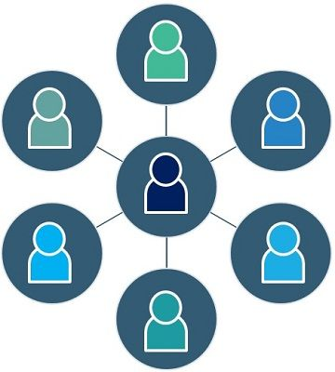

Slide 74
Reasons for centralization
1. Achieving uniformity of Action:
Uniformity of action is possible when decision making authority is centralized. The decision taken at the top will be implement at every level. There may be more than one unit under the same management and it may be desired to have same types of policies and procedures. If the units take their independent decisions then uniformity of action will not be achieved. Under such situations centralized decision making will enable unity of action.
2. Facilitating Integration
There may be a need to integrate all operations of the enterprise for achieving common objectives. Centralized management will facilitate integration of activities by devising common policies and programmed.

Slide 75
3. Promoting Personal Leadership:
The small enterprise grow on the strength and capability of their manager. Even big concerns too depend upon the qualities of their managers during initial periods. The whole authority will be in the hands of chief executive. This will results in quick decisions and Imaginate actions. The manager will acquire more and more skill and experience which will promote their personal leadership.
4. Handling Emergencies
Under uncertain business conditions there is a need to take emergency decisions. Sometimes the existence of small scale units is endangered if timely actions are not taken. Centralized authority will enable quick and timely decisions from short term as well long term perspective.

Slide 76
Advantages of Centralization
1. A clear chain of command
A centralized organization benefits from a clear chain of command because every person within the organization knows who to report to. Junior employees know who to approach whenever they have concerns about the organization.
2. Focused vision
When an organization follows a centralized management structure, it can focus on the fulfillment of its vision with ease. There are clear lines of communication and the senior executive can communicate the organization’s vision to employees and guide them toward the achievement of the vision.

Slide 77
3. Reduced costs
A centralized organization adheres to standard procedures and methods that guide the organization, which helps reduce office and administrative costs. The main decision-makers are housed at the company’s head office or headquarters, and therefore, there is no need for deploying more departments and equipment to other branches.
4. Quick implementation of decisions
In a centralized organization, decisions are made by a small group of people and then communicated to the lower-level managers. The involvement of only a few people makes the decision-making process more efficient since they can discuss the details of each decision in one meeting.

Slide 78
5. Improved quality of work
The standardized procedures and better supervision in a centralized organization result in improved quality of work. There are supervisors in each department who ensure that the outputs are uniform and of high quality.
The use of advanced equipment reduces potential wastage from manual work and also helps guarantee high-quality work. Standardization of work also reduces the replication of tasks that may result in high labor costs.

Slide 79
Disadvantages of Centralization
1. Bureaucratic leadership
Centralized management resembles a dictatorial form of leadership where employees are only expected to deliver results according to what the top executives assign them. Employees are unable to contribute to the decision-making process of the organization, and they are merely implementers of decisions made at a higher level.
2. Remote control
The organization’s executives are under tremendous pressure to formulate decisions for the organization, and they lack control over the implementation process. The failure of executives to decentralize the decision-making process adds a lot of work to their desks.

Slide 80
3. Delays in work
Centralization results in delays in work as records are sent to and from the head office. Employees rely on the information communicated to them from the top, and there will be a loss in man-hours if there are delays in relaying the records. This means that the employees will be less productive if they need to wait long periods to get guidance on their next projects.
4. Lack of employee loyalty
Employees become loyal to an organization when they are allowed personal initiatives in the work they do. They can introduce their creativity and suggest ways of performing certain tasks. However, in centralization, there is no initiative in work because employees perform tasks conceptualized by top executives. This limits their creativity and loyalty to the organization due to the rigidity of the work.

Slide 81
Decentralization
Decentralization is referred to as a form of an organizational structure where there is the delegation of authority by the top management to the middle and lower levels of management in an organization.
In this type of organization structure, the duty of daily operations and minor decision-making capabilities are transferred to the middle and lower levels which allow top-level management to focus more on major decisions like business expansion, diversification etc.
Delegation refers to the assigning a portion of work and the associated responsibility by a superior to a subordinate. In simple words, when delegation is expanded on an organisational level, it is called decentralization

Slide 82
Importance of Decentralization
Rapid decision making – Most of the decisions are taken on the spot, and approval from the higher authority is not required. The ability to make a prompt decision allows an organization to function its operation quickly and effectively.
Administrative development – The decentralization process questions the manager’s judgement and techniques, when responsibility and challenges to develop solutions are given to them. This questioning method grows confidence, encourages self-reliance, and make them a good decision-maker resulting in the development of the organization.
Development of executive skills – It allows the employee to perform task individually, giving them invaluable exposure. This individual performance creates an environment where an individual can enhance their expertise, take ownership & more significant responsibilities, and be suitable for promotion.

Slide 83
4.Promotes growth – Decentralization also allows the heads of the department to work independently. This independence helps the department to grow, have a healthy competition between other departments. Ultimately, the competition will lead to an improvement and enhancement in productivity.
5.Higher control – It also evaluates and reviews the performances of each department and gives them a comprehensive perspective of their work. However, controlling is the biggest challenge of decentralization and stabilized management and scorecard are being developed.

Slide 84
Disadvantages of decentralization
1. Conflict:
Decentralization puts increased pressure on divisional heads to realize profits at any cost. This may lead to inter-divisional rivalry leading to bitter fights. Each divisional head might be tempted to build his own empire at the cost of others. Problems of coordination and control may also arise when such ‘mini-companies’ or ‘little empires’ exist within an organization.
2. Increase in expenditure:
Decentralization results in a duplication of staff effort. To be in­dependent, each division should have access to purchasing, personnel, marketing and other specialists. As a result each division is expected to carry a large group of staff specialists at enormous cost.

Slide 85
3.Difficult To Co-Ordinate
While talking about the advantages and disadvantages of decentralization, it is imperative to note that substantial autonomy is enjoyed by every single division. This, in turn, makes it difficult to coordinate the overall activity.
4. Unusable for emergency situations
5. Unusable for specialized services

Slide 86
Staffing
Staffing is the process of determination of manpower and recruitment, selection, appointment and placement of right person to the right job.
Staffing is the process of hiring eligible candidates in the organization or company for specific positions. In management, the meaning of staffing is an operation of recruiting the employees by evaluating their skills, knowledge and then offering them specific job roles accordingly.

Slide 87
Importance of staffing
1.Efficient Performance of Other Functions
For the efficient performance of other functions of management, staffing is its key. Since, if an organization does not have the competent personnel, then it cannot perform the functions of management like planning, organizing and control functions properly.
2.Effective Use of Technology and Other Resources
What is staffing and technology’s connection? Well, it is the human factor that is instrumental in the effective utilization of the latest technology, capital, material, etc. the management can ensure the right kinds of personnel by performing the staffing function.

Slide 88
3.Optimum Utilization of Human Resources
The wage bill of big concerns is quite high. Also, a huge amount is spent on recruitment, selection, training, and development of employees. To get the optimum output, the staffing function should be performed in an efficient manner.
4.Development of Human Capital
Another function of staffing is concerned with human capital requirements. Since the management is required to determine in advance the manpower requirements. Therefore, it has also to train and develop the existing personnel for career advancement. This will meet the requirements of the company in the future.

Slide 89
5.The Motivation of Human Resources
In an organization, the behavior of individuals is influenced by various factors which are involved such as education level, needs, socio-cultural factors, etc. Therefore, the human aspects of the organization have become very important and so that the workers can also be motivated by financial and non-financial incentives in order to perform their functions properly in achieving the objectives.
6.Building Higher Morale
The right type of climate should be created for the workers to contribute to the achievement of the organizational objectives. Therefore, by performing the staffing function effectively and efficiently, the management is able to describe the significance and importance which it attaches to the personnel working in the enterprise.

